Slide 1
Project title: Identify signs of diabetic retinopathy in eye images
BY
A.G.PRASOONA
A.NEELIMA DEVI
KOTLA CHINMAI
SRUJANA MIRIYALA

Slide 2
introduction
Overview
Diabetic retinopathy is a diabetes complication that affects eyes. It's caused by damage to the blood vessels of the light-sensitive tissue at the back of the eye (retina).
At first, diabetic retinopathy may cause no symptoms or only mild vision problems. Eventually, it can cause blindness.
The condition can develop in anyone who has type 1 or type 2 diabetes. The longer you have diabetes and the less controlled your blood sugar is, the more likely you are to develop this eye complication.

Slide 3
Symptoms You might not have symptoms in the early stages of diabetic retinopathy. As the condition progresses, diabetic retinopathy symptoms may include: Spots or dark strings floating in your vision (floaters). Blurred vision. Fluctuating vision. Impaired color vision. Dark or empty areas in your vision. Vision loss. Diabetic retinopathy usually affects both eyes.

Slide 4
causes
Over time, too much sugar in your blood can lead to the blockage of the tiny blood vessels that nourish the retina, cutting off its blood supply. As a result, the eye attempts to grow new blood vessels. But these new blood vessels don't develop properly and can leak easily.
There are two types of diabetic retinopathy.
Early diabetic retinopathy:
In this more common form — called non-proliferative diabetic retinopathy (NPDR) — new blood vessels aren't growing (proliferating).
When you have NPDR, the walls of the blood vessels in your retina weaken. Tiny bulges (microaneurysms) protrude from the vessel walls of the smaller vessels, sometimes leaking fluid and blood into the retina. Larger retinal vessels can begin to dilate and become irregular in diameter, as well. NPDR can progress from mild to severe, as more blood vessels become blocked.
Nerve fibers in the retina may begin to swell. Sometimes the central part of the retina (macula) begins to swell (macular edema), a condition that requires treatment.

Slide 5
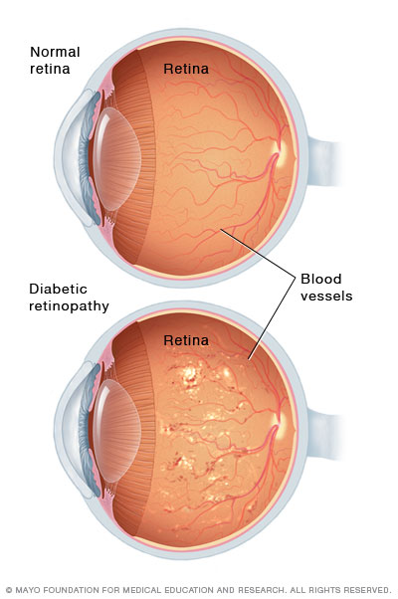
Advanced diabetic retinopathy:
Diabetic retinopathy can progress to this more severe type, known as proliferative diabetic retinopathy. In this type, damaged blood vessels close off, causing the growth of new, abnormal blood vessels in the retina, and can leak into the clear, jelly-like substance that fills the center of your eye (vitreous).
Eventually, scar tissue stimulated by the growth of new blood vessels may cause the retina to detach from the back of your eye. If the new blood vessels interfere with the normal flow of fluid out of the eye, pressure may build up in the eyeball. This can damage the nerve that carries images from your eye to your brain (optic nerve), resulting in glaucoma.

Slide 6
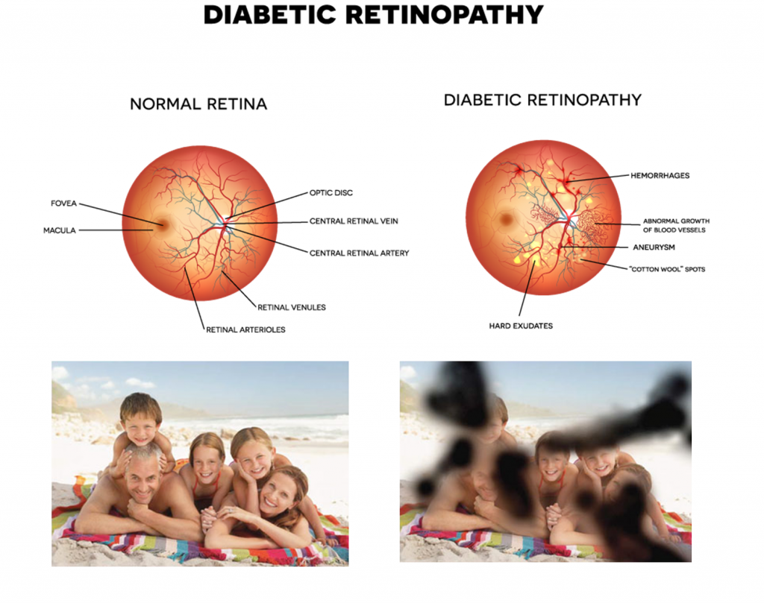
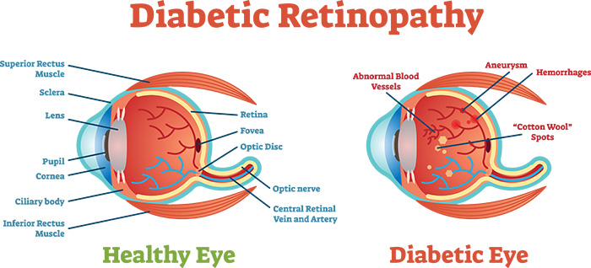

Slide 7
Problem statement
Diabetic retinopathy is an eye disease caused by diabetes that can lead to loss of vision or even complete blindness. Diabetic retinopathy accounts for 12% of all new cases of blindness in the United States, and is the leading cause of blindness for people aged 20 to 64 years. Diabetic retinopathy is a diabetes complication that affects eyes. It's caused by damage to the blood vessels of the light-sensitive tissue at the back of the eye (retina) Millions of people suffer from diabetic retinopathy, the leading cause of blindness among working aged adults. So,we have to build an application ui such that it can predict the disease by using deep learning(convolution neural network).

Slide 8
solution
The main objective is to scale the efforts of lab technicians through technology to gain the ability to automatically screen images for disease and provide information on how severe the condition may be. This project is capable of classifying images based on disease pathology from four severity levels. A convolutional neural network (CNN) convolves an input image with a defined weight matrix to extract specific image features without losing spatial arrangement information. There will be a web application through which user can give their input image then they can check the predicted output and this application is integrated with trained CNN model.

Slide 9
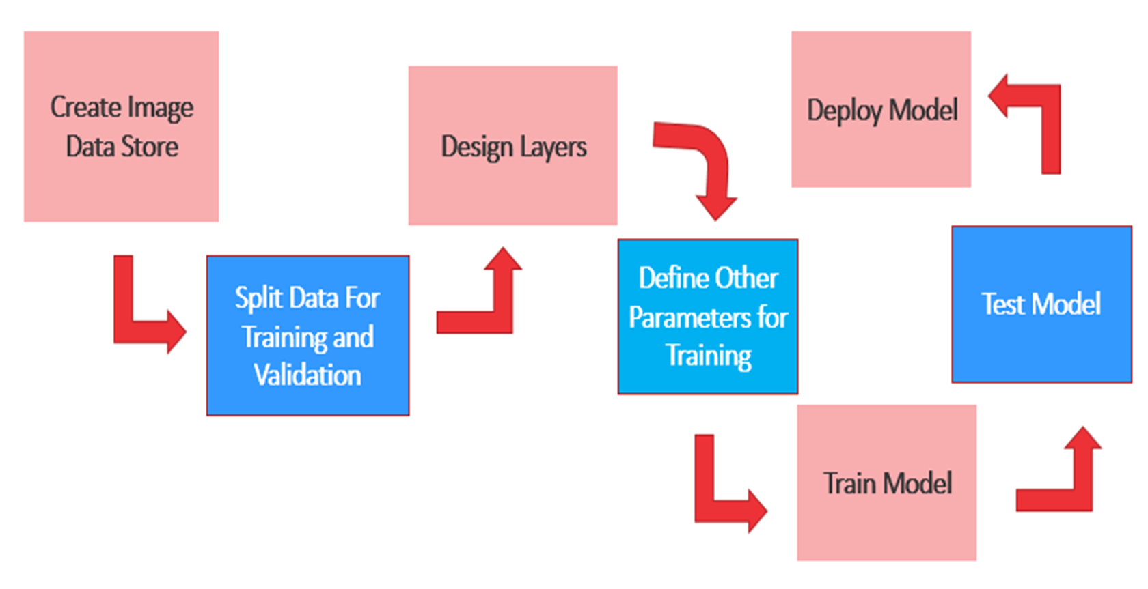
Flow chart

Slide 10
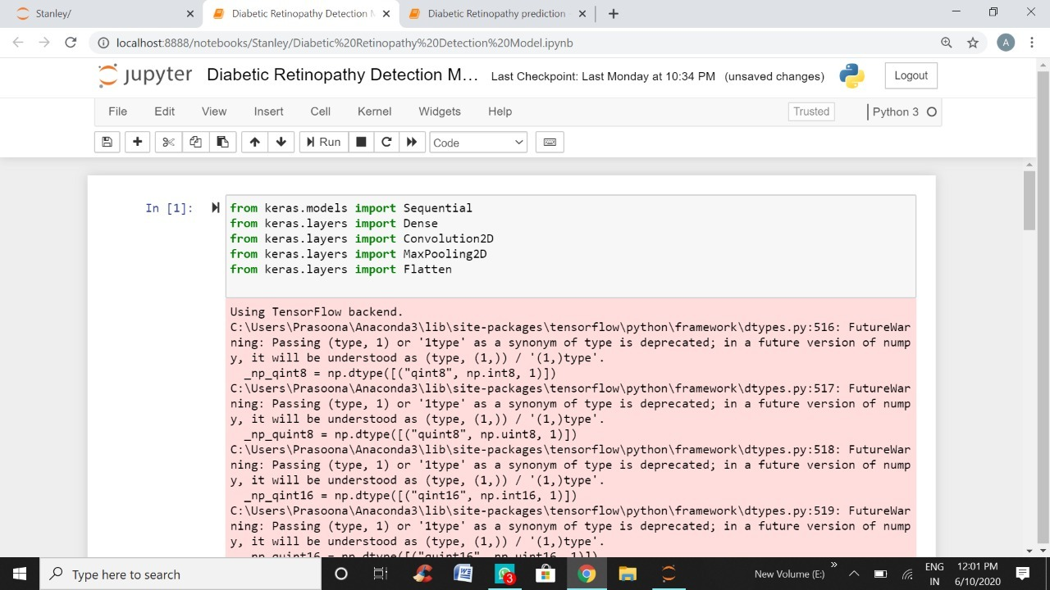

Slide 11
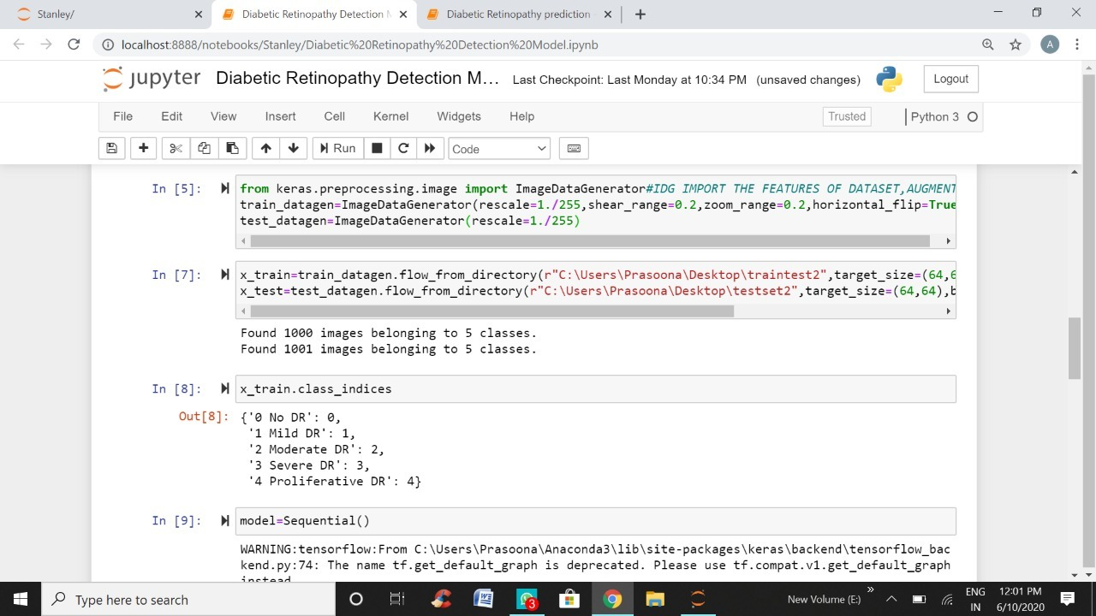

Slide 12
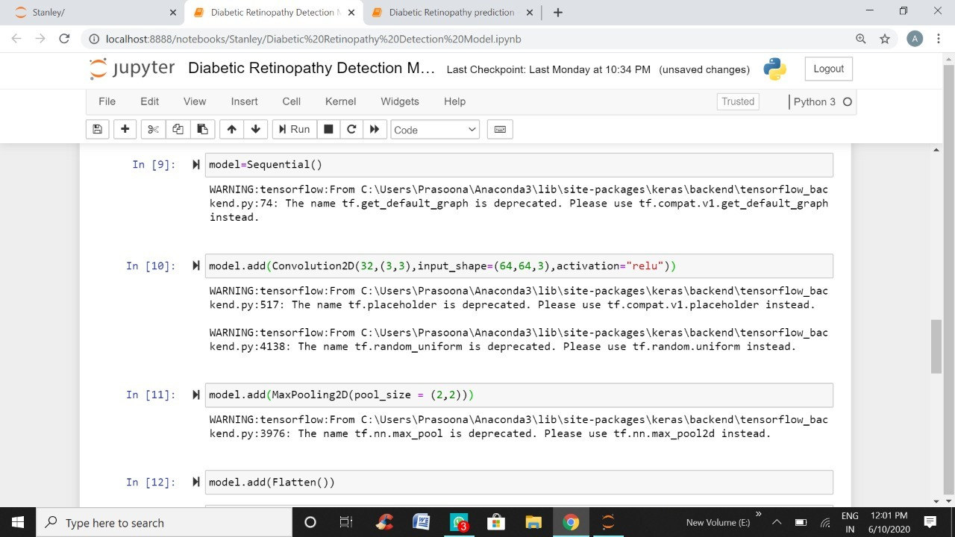

Slide 13
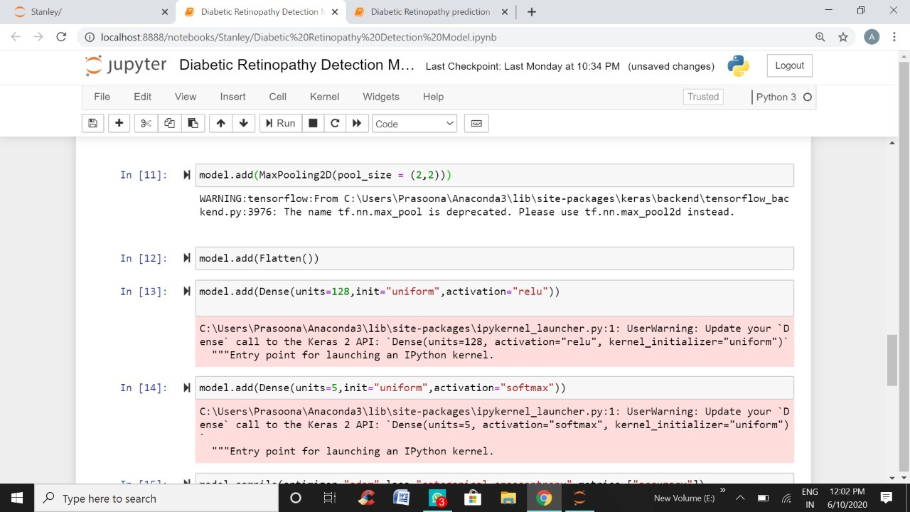

Slide 14
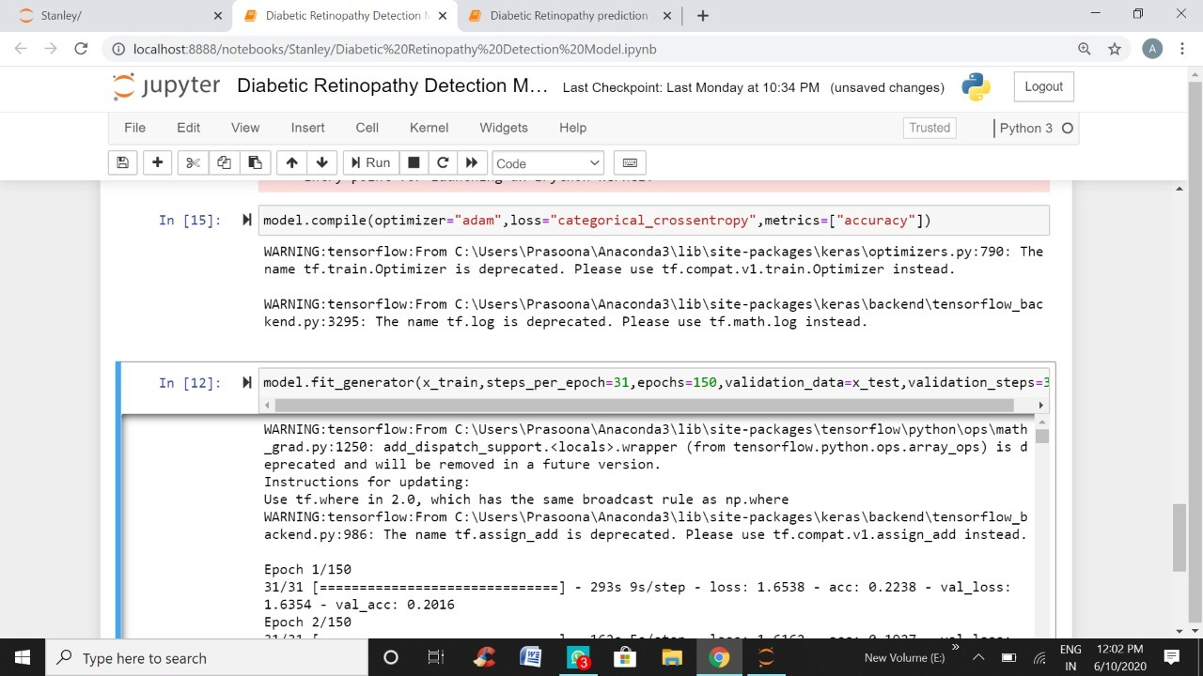

Slide 15
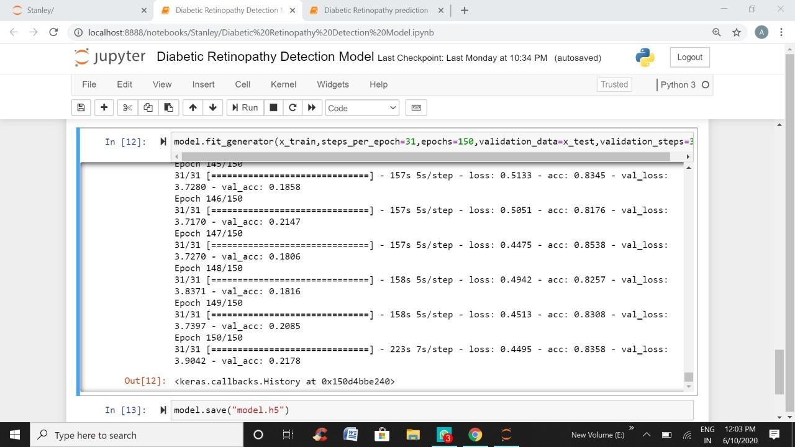

Slide 16
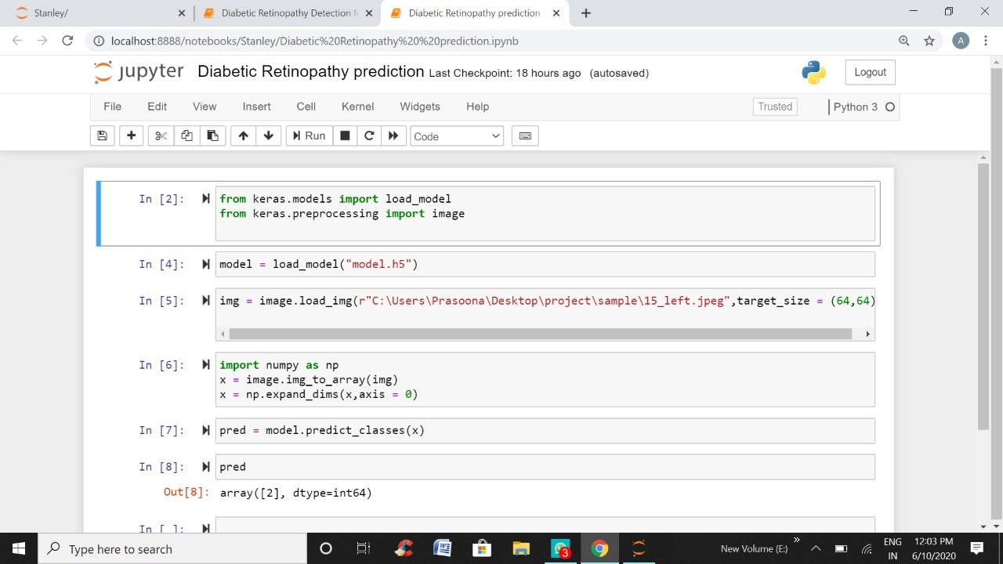

Slide 17
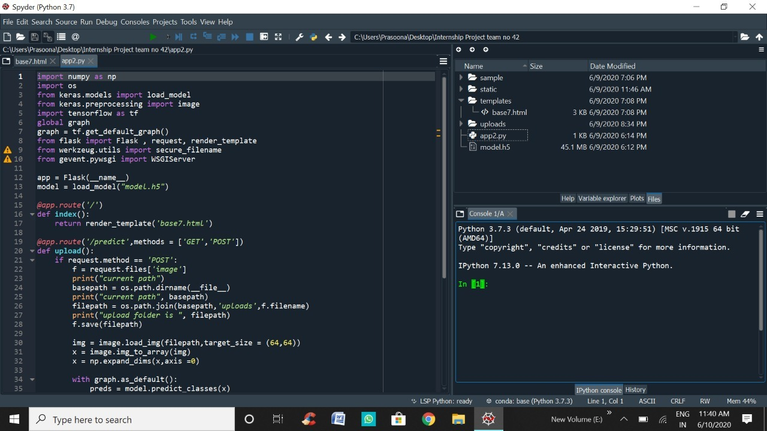

Slide 18
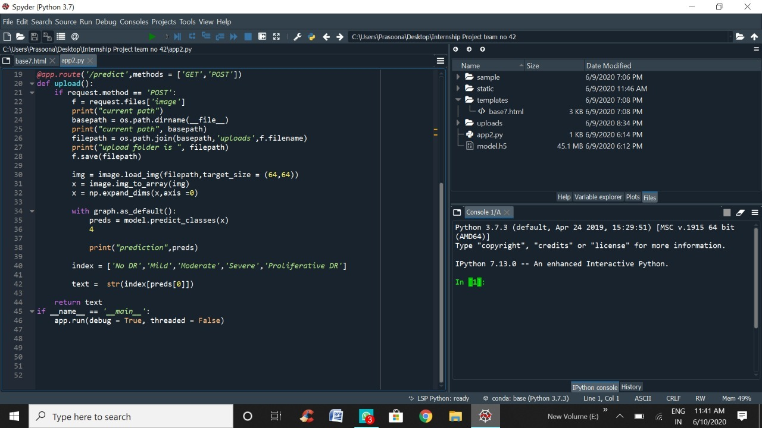

Slide 19
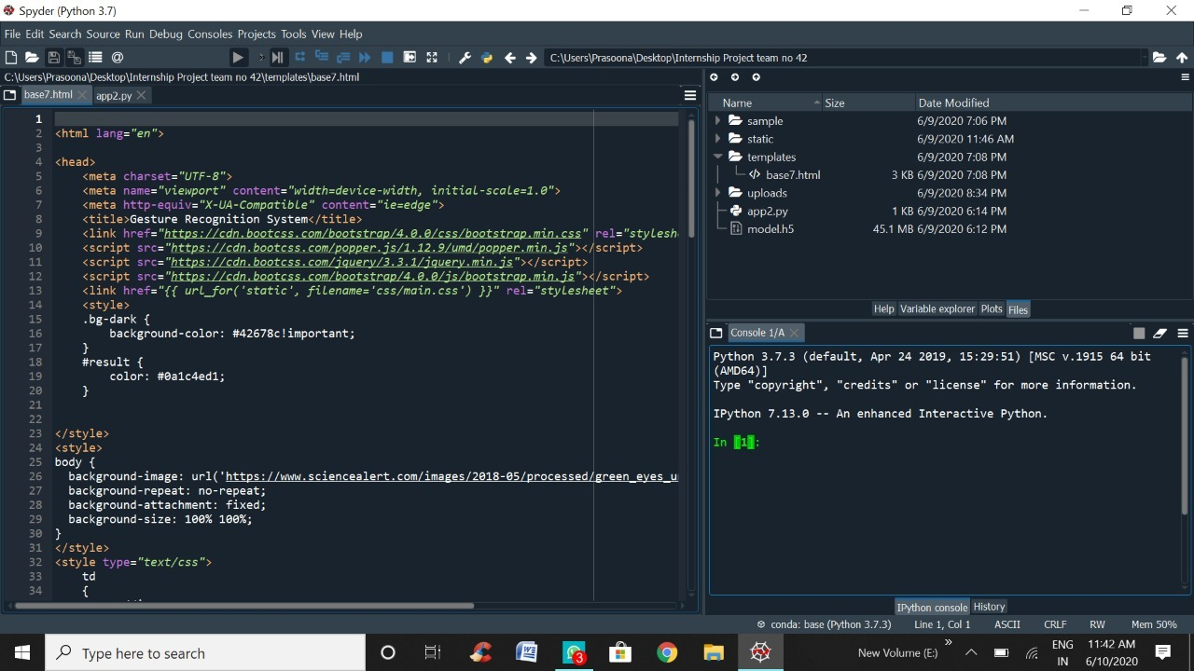

Slide 20


Slide 21
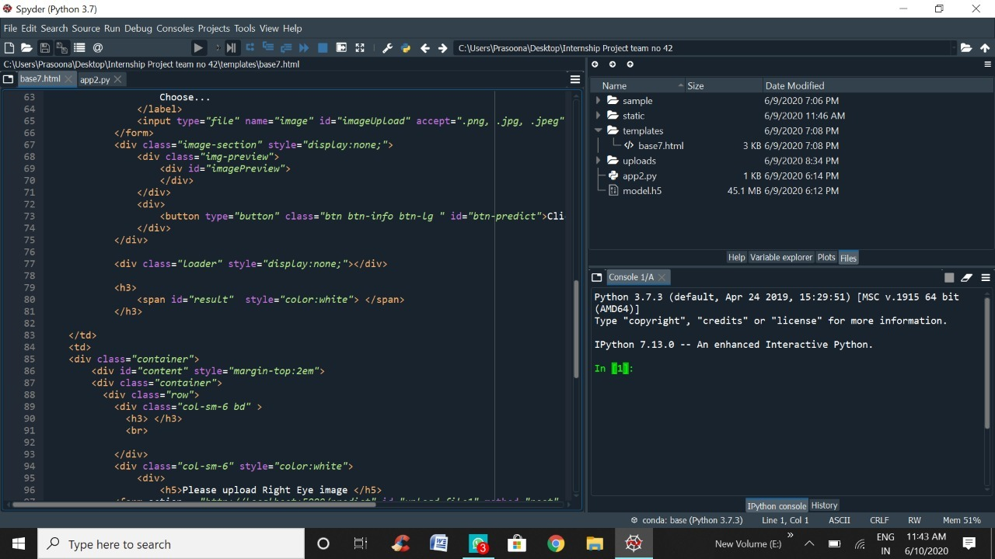

Slide 22
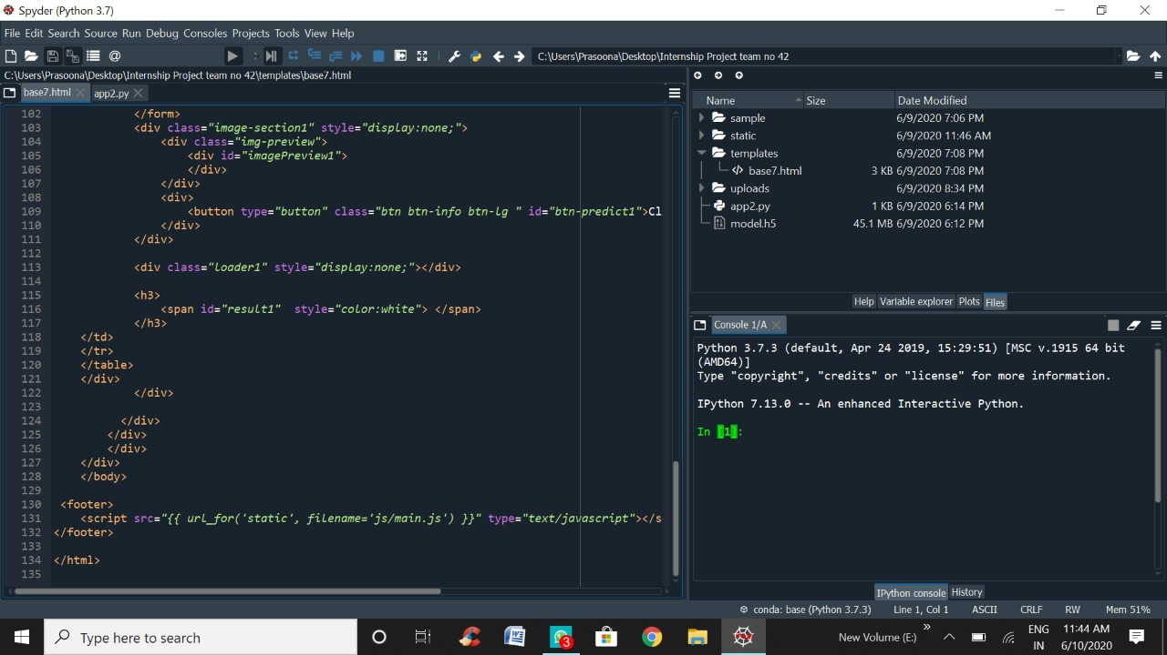

Slide 23
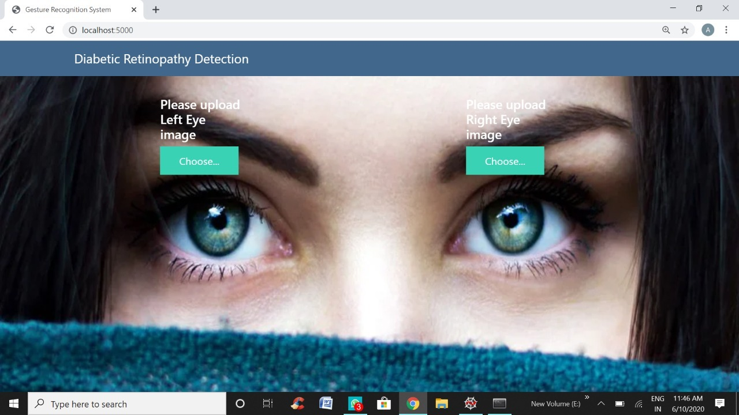

Slide 24
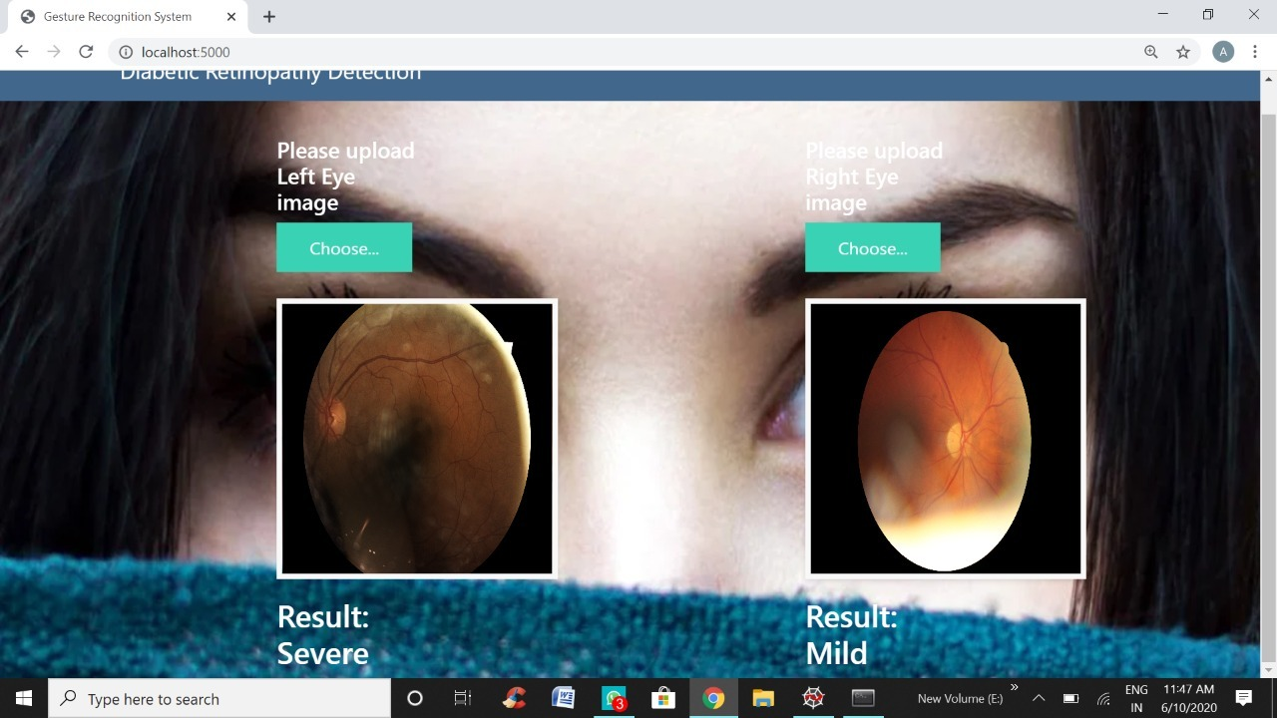

Slide 25
conclusion
Automated detection and screening offers a unique opportunity to prevent a significant proportion of vision loss in our population. In recent years, researchers have added CNNs into the set of algorithms used to screen for diabetic disease. CNNs promise to leverage the large amounts of images that have been amassed for physician interpreted screening and learn from raw pixels. The high variance and low bias of these models could allow CNNs to diagnose a wider range of nondiabetic diseases as well.

Slide 26
However, while we achieve state-of-the-art performance with CNNs using binary classifiers, the model performance degrades with increasing number of classes. Though it is tempting to surmise that more data may be better, previous work in the field has corroborated that CNN ability to tolerate scale variations is restricted and others have suggested that in the case of retinal images, more data cannot supplement for this inherent limitatio25,14. Gulshan et al. reported a 93-96% recall for binary classification of disease but reports that recall is not improved when training with 60,000 samples vs 120,000 samples of a private dataset.
Visualizations of the features learned by CNNs reveal that the signals used for classification reside in a portion of the image clearly visible by the observer26. Moderate and severe diabetic retinal images contain macroscopic features at a scale that current CNN architectures, such as those available from the ImageNet visual database, are optimized to classify. Conversely, the features that distinguish mild vs normal disease reside in less than 1% of the total pixel volume, a level of subtleness that is often difficult for human interpreters to detect.

Slide 27
Medical images are fraught with subtle features that can be crucial for diagnosis. Fortunately, the most often deployed architectures have been optimized to recognize macroscopic features such as those present in the ImageNet dataset. We may therefore require a new paradigm for diagnosing diseases via CNN models. This could be a two stage lesion detection pipeline that involves feature localization followed by classification and further preprocessing steps to segment out pathologies difficult to discern by manual inspection, and finally rebalancing network weights to account for class imbalances seen in medical datasets. Overall, our future goals involve improving detection of mild disease and transitioning to more challenging and beneficial multi-grade disease detection.

Slide 28
Thank you

